Slide 1
EE 521/ECE 582 – Analysis of Power systems
Class #13 – October 11, 2022
Dr. Noel N. Schulz
Edmund O. Schweitzer III Chair in
Power Apparatus and Systems
Chief Scientist Joint Appointment, PNNL
Co-Director, PNNL/WSU Advanced Grid Institute (AGI)
Washington State University Pullman
Noel.Schulz@wsu.edu EME 35
509-335-0980 (o) and 509-336-5522 (c)

Slide 2
Reminders
Student Hours This Week
Tuesday 4:30-5:30 pm (after class) – Zoom or EME 35 Pullman
Check in Meetings
Wednesday 3-5 pm Zoom
Thursday 9:30-11 am Zoom or EME 35 Pullman
Friday 11am -12 pm Zoom or EME 35 Pullman
Remember the Discussion Set Assignment
10/11 Discussions
Final Paper – Think about Topic - Oct 14

Slide 3
Final Paper and Presentation
Pick one of the topics related to the class and find at least five IEEE journal papers (four of the papers must be in the last 15 years) that discuss different research or work on that topic. One paper can be from the discussion sets.
Write a paper that summarizes these journal papers and discusses the how they relate to topics covered in class.
During the last two weeks of class (after Thanksgiving Break), present a 10-12 minute presentation on your topic summarizing the papers and discussing how it relates to the class. There will be peer review of presentations.
Steps | Activity | Due Date:
Pick a Topic | Upload Topic on Canvas | Oct 14
Presentations | 10-12 min presentation with Q&A | Nov 29, Dec 1,6 & 8
Paper | 4-5 pages – Summary & how topic relates to class | Dec 9

Slide 4
Topics for Final Paper – Upload by Friday
Other Possible Aspects:
Distribution
AI/ML
Data Science
New Numerical Techniques
Power Electronics
Microgrids
Modeling of Renewable Energy Resources within Analysis
Modeling of Storage within Analysis
Keywords:
Power Flow
Newton Raphson
Fast Decoupled
Sparse Power Flow
Continuation Power Flow
State Estimation
Optimal Power Flow

Slide 5
Paper Discussion Set #2
EE 521/ECE 582 Discussion Paper Set #2
Assignment with Deadlines – 10/18, 10/21 and 10/28, 11:59 pm
Read at least three of the papers listed in Assignment – Discussion Assignment Paper Set #2.
Students listed below provide a summary of their article on discussion board by 10/18
Students listed below provide a list of at least three questions for class members to answer.
All students should provide answers to the questions or add to the discussions for at least three papers.
Assignment #2 | Column A: Summarize (150 to 200 word summary of article) | Column B: List of three questions for class to answer? | Column C: Answer the Questions or Add to Discussions (Each response should be between 25 and 100 words)
See Canvas for Papers | Due: 10/18 | Due: 10/21 | Due: 10/28
Paper #1 | Liadi Akande | Noah Allison | All students in class should respond to three of these papers.
Paper #2 | Jacob Hastings | Sajjad Uddin Mahmud | All students in class should respond to three of these papers.
Paper #3 | Asif Iftekhar Omi | Md Samiul Islam Sagar | All students in class should respond to three of these papers.
Paper #4 | Sumanjali Pannala | Saeed Salimi Amiri | All students in class should respond to three of these papers.
Paper #5 | Md Mehedi Hasan Tanim | Leonardo Stingini | All students in class should respond to three of these papers.
Paper #6 | Hassan Yazdani | Ke Wang | All students in class should respond to three of these papers.

Slide 6
Paper Discussion Set #3
EE 521/ECE 582 Discussion Paper Set #3
Assignment with Deadlines – 11/8, 11/10 and 11/18, 11:59 pm
Read at least three of the papers listed in Assignment – Discussion Assignment Paper Set #3
Students listed below provide a summary of their article on discussion board by 11/8
Students listed below provide a list of at least three questions for class members to answer.
All students should provide answers to the questions or add to the discussions for at least three papers.
Assignment #3 | Column A: Summarize (150 to 200 word summary of article) | Column B: List of three questions for class to answer? | Column C: Answer the Questions or Add to Discussions (Each response should be between 25 and 100 words)
See Canvas for Papers | Due: 11/8 | Due: 11/10 | Due: 11/18
Paper #1 | Noah Allison | Ninad Gaikwad | All students in class should respond to three of these papers.
Paper #2 | Sajjad Uddin Mahmud | Aryan Jha | All students in class should respond to three of these papers.
Paper #3 | Md Samiul Islam Sagar | Annika Lawrence | All students in class should respond to three of these papers.
Paper #4 | Saeed Salimi Amiri | Ben McCornack | All students in class should respond to three of these papers.
Paper #5 | Leonardo Stingini | Mauricio Silveira | All students in class should respond to three of these papers.
Paper #6 | Ke Wang | Augusto Zanin Bertoletti | All students in class should respond to three of these papers.

Slide 7
Power System Analysis Techniques --
Power Flow
Newton Raphson
Fast Decoupled
Sparse Power Flow
Continuation Power Flow
State Estimation
Optimal Power Flow

Slide 11
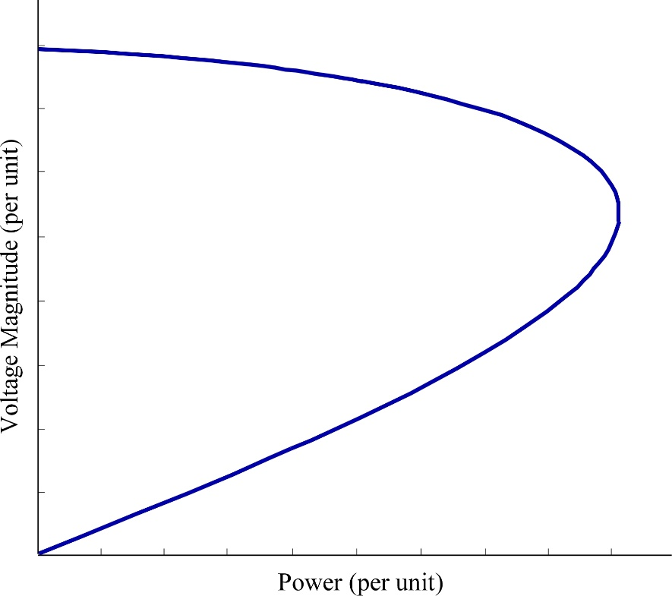
PV Curves and Continuation Power Flow
What happens to the Jacobian when the load is here?
Plot bus voltage as the load is gradually increased:
This is can be represented as a homotopy problem when the load increases with λ
This is called the PV or “nose” curve
The slope is zero
→ The Jacobian becomes singular

Slide 12
Continuation flow equations:
predict
Two possible predictor/correctors combinations:
Δλ
correct
predict
Power (λ) – predict
ΔV
correct
Note that the correction is in the x (voltage) direction
Voltage – predict V ^{i+1} = V ^{i} + ΔV
Note that the correction is in the λ (power) direction

Slide 13
Let the continuation power flow equations
be written as:
To find the predicted values:

Slide 14
Let this be stepsize σ
This is the power flow Jacobian
This is K
This still needs one more equation
Last equation: Δλ = σ

Slide 15
Complete set of equations. Δθ and ΔV are vectors.
Predictor:
Corrector: Solve power flow equations:

Slide 16
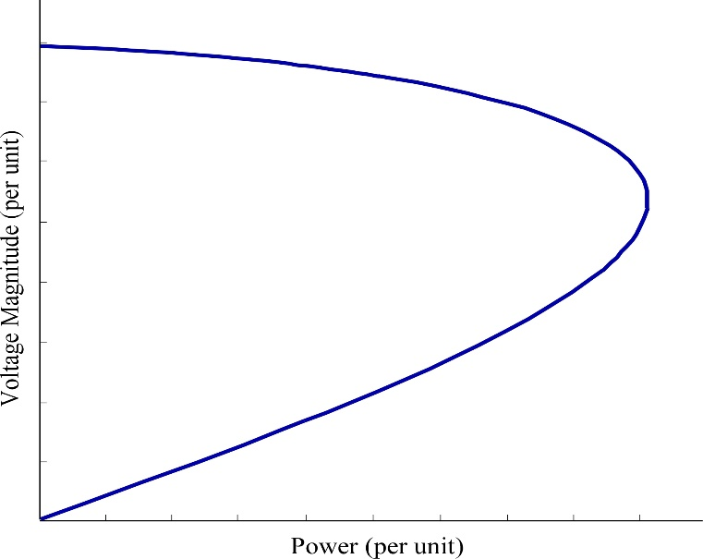
This works until we get close to the tip of the PV curve and the Jacobian becomes ill-conditioned.
At that point, the continuation parameter switches from λ to one of the voltages (typically the lowest voltage). The predictor step is then modified:
predict
ΔV
The -1 is at the entry that corresponds to the voltage that is selected as the new continuation parameter.
The ‘-’ is because the voltage will decrease from i to i+1.

Slide 17
For the corrector step, λ is now an unknown. The set of equations is increased by the continuation equation in V_{c} (where c is the chosen bus).
These are solved simultaneously using the NR algorithm.
Corrector:

Slide 18
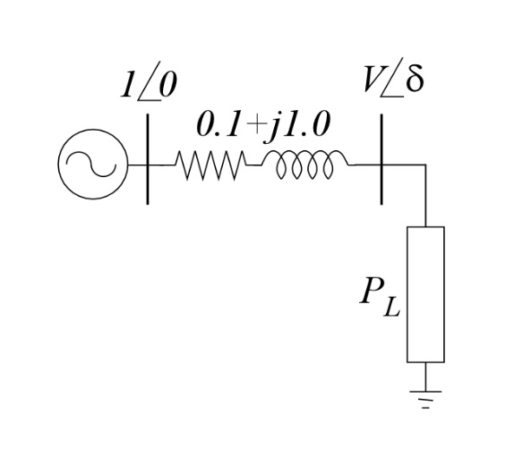
Example: Plot PV curve for the system:
Continuation equations:
Negative because P_{inj} is negative (i.e. a load)
Since Q_{L} = 0,
Predictor:

Slide 19
The Jacobian is:
Predictor (σ = 0.1):
at flat start
In radians
λ is now predicted to be 0.1

Slide 20
Corrector Step:
Second iteration:
This is the usual power flow NR
After the first iteration:
(Pretty close to the predicted value)

Slide 21
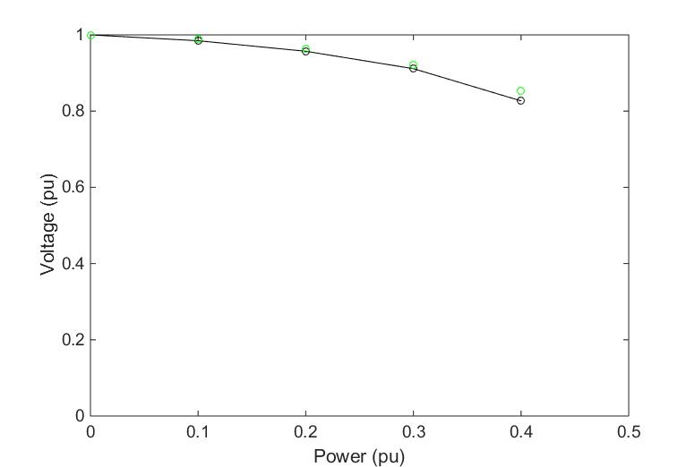
Continue with λ as continuation parameter until V < 0.9
Predicted values. Note that the correction direction is vertical (i.e. in the voltage direction)

Slide 22
Now switch continuation parameter to V:
Predictor Step:
Change σ to 0.025 because voltage changes at a slower rate than power
Reflects change in continuation parameter

Slide 23
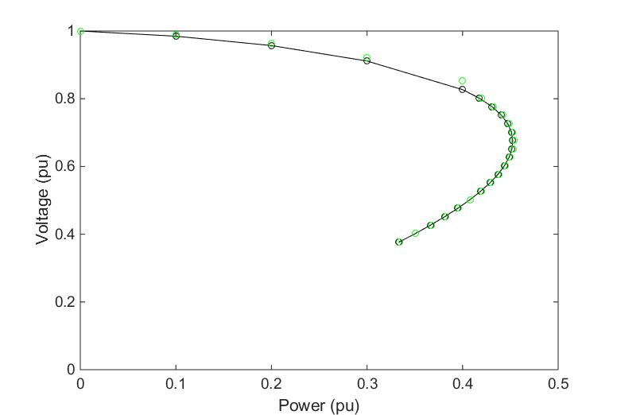
Continuation equations:
3 equations in 3 unknowns
Corrector Step:
Predicted values. Note that the correction direction is horizontal (i.e. in the power direction)

Slide 24
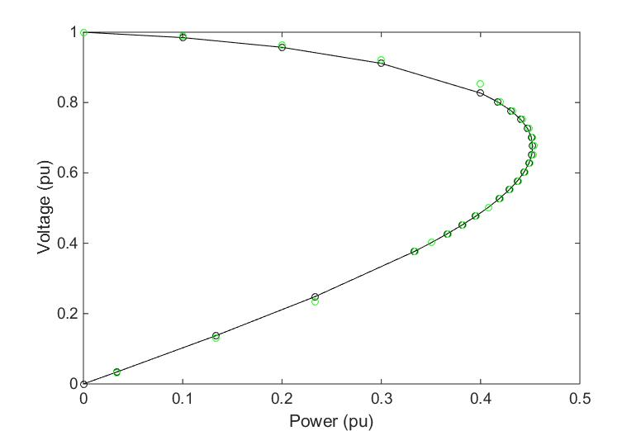
Now switch continuation parameter back to σ:
Predictor Step:
Change σ back to 0.1
Reflects change in continuation parameter. Is negative because on the lower part of the curve, the power is decreasing.
Corrector Step: Same as top of curve – just usual NR power flow

Slide 26
Announcements
Re-Review Sections 3.5.5 & 3.5.6
Start Reading Chapter 6
Papers for Discussion Set #1 – Responses by 10/11
Set up Time for Program #1 Discussions

